Slide 1
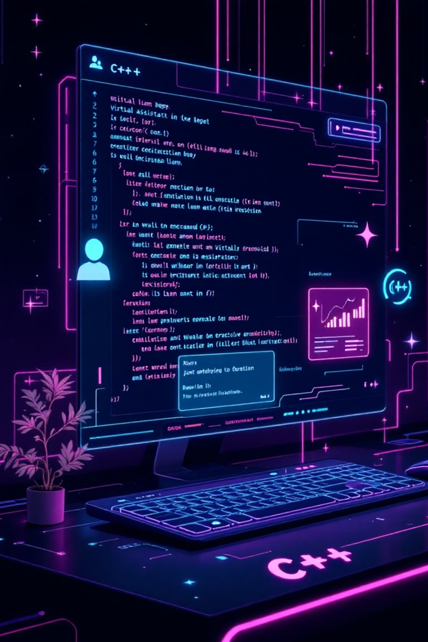

🚀 “C++ Virtual Assistant Project – Nova: A Smart Virtual Desktop Companion”

Slide 2





CHAPTER 1: Introducing Nova
The C++ Virtual Assistant: Nova
A C++-Based Companion
Interactive Communication
Demonstrating Core Concepts
It showcases key C++ concepts: Object-Oriented Programming (OOP), system-level commands, file handling, and real-time clock management using the <ctime> library.
This project is a C++-based Virtual Assistant named Nova, designed as an intelligent desktop companion.
Nova interacts with users through Text-To-speech application called e-speak offering conversational responses.

Slide 3
Core Objectives and Usability
Nova was designed with a focus on automation, integration, and modularity to provide a practical and efficient user experience.
Automate Simple Tasks
OS Command Integration
Create a voice-interactive desktop assistant capable of quickly executing simple tasks like launching applications or opening URLs.
Demonstrates how to integrate C++ logic with OS shell commands (via system()) for real-world application control.
Voice & Text Output
Scalability & Modularity
Responds with both text confirmation and synthesized voice output using the espeak library for enhanced user feedback.
Designed to be highly modular, allowing for easy expansion into a more advanced, potentially AI-powered assistant in the future.

Slide 4






Nova's Capabilities
Key Features: What Nova Can Do
Voice Interaction
Web Navigation
🎙️ Provides voice responses for all key interactions, with the help of espeak system calls.
🌐 Can open specified websites like Google, YouTube, or custom URLs using OS commands.
Basic Calculator
Note Management
🧮 Built-in utility to perform simple arithmetic calculations with immediate results.
🗒️ Simple note-taking system to add, view, or clear personalized notes using file persistence.
Date & Time
Conversational Talk
🕒 Displays the real-time date and time, managed efficiently using the <ctime> library.
💬 Responds to common greetings, small talk, and injects light humor to enhance the user experience.

Slide 5




CHAPTER 2: Architecture and Design
Applying Object-Oriented Principles (OOP)
Nova's structure is built on four core OOP pillars, ensuring the code is organized, scalable, and maintainable.
Encapsulation
Abstraction
Each function, such as managing notes or calculations, is contained within its dedicated class, bundling data and methods.
The user only sees the high-level commands (e.g., "calculate"); the complex underlying C++ logic and OS calls remain hidden.
Modularity & Reusability
Composition
Individual classes are independent components that can be reused, upgraded, or replaced without affecting the entire system.
The Virtual Assistant class acts as the controller, creating and managing objects of other classes. It combines all modules to work together, forming a cohesive and scalable assistant.

Slide 6





Modular Class Structure
The project uses dedicated classes to separate concerns, making development and debugging significantly simpler.
Greeter
Handles initial greetings, conversational responses, and farewell messages for a human touch.
TaskManager
Responsible for system operations: opening websites, launching local applications, and displaying system info.
Calculator
Dedicated to parsing input and performing arithmetic operations, providing both text and voice results.
Notes
Manages persistent data storage for notes using file I/O operations (saving, reading, and clearing data).
VirtualAssistant (Core)
The central hub that accepts user input, routes commands to the appropriate module, and maintains the main program loop.

Slide 7

CHAPTER 3: Implementation Details
Processing User Input and Command Matching
Input is continuously read using getline(cin, input) within the main loop.
The program scans the input string for predefined **keywords** using the C-style function strstr().
Upon finding a match, the corresponding class method is called (e.g., TaskManager::openWebsite() or Calculator::calculate()).
Example: If the input contains "open google," the TaskManager is instructed to launch the browser.
Current Limitation: strstr() is case-sensitive, requiring users to type commands in lowercase (e.g., "time" not "Time").
Improvement: This can be fixed by converting the entire input to lowercase immediately upon reception using the C++ standard library’s transform function for robust input handling:
transform(input.begin(), input.end(), input.begin(), ::tolower);

Slide 8


Interacting with the OS: The system() Function
The system() function is crucial as it bridges the gap between C++ code and the underlying operating system's shell.
Direct OS Access
External Control
Allows the C++ program to execute arbitrary commands as if they were typed directly into the command line or terminal.
Used to launch external applications or open URLs, providing Nova its functional capabilities (e.g., system("start notepad")).
Voice Synthesis
Powers the voice output by making calls to the espeak utility via the OS command line, dynamically speaking text responses.
Example usage for opening a URL: system("start https://www.google.com");

Slide 9


Real-Time Data: Leveraging the <ctime> Library
The <ctime> library is essential for accurate retrieval and formatting of the system date and time.
Crucial Adjustments for Display
Key Code Snippet
Since the tm structure uses zero-based or offset values, manual adjustments are necessary for correct human-readable output:
time_t now = time(0);
tm* ltm = localtime(&now);
Months Offset:
The time(0) function returns the current calendar time as a time_t value.
Months start at 0 (January=0), so we must use 1 + ltm->tm_mon.
The localtime() function converts this time into a broken-down structure (tm) specific to the local time zone.
Year Offset:
The structure members provide components like tm_hour, tm_min, tm_mday, tm_mon, and tm_year.
Years are counted from 1900, requiring 1900 + ltm->tm_year to get the actual current year.

Slide 10


Persistent Data Storage: File Handling with <fstream>
Nova's notes system utilizes the <fstream> library to provide **persistent data storage**, allowing notes to survive program restarts.
Take Note (Writing)
1
Uses std::ofstream open in ios::app (append) mode. New notes are added to the end of "notes.txt" without overwriting existing data.
2
Show Notes (Reading)
Uses std::ifstream to read and display the entire contents of "notes.txt" to the user.
Clear Notes (Clearing)
3
The file is opened in ios::trunc (truncate) mode, which effectively clears all previous content, followed by closing the file.
This combination of OOP classes and robust file handling provides a practical, working assistant experience.

Slide 11
Roadmap for Future Enhancements
Step 1:
Step 2:
Step 3:
Step 4:
Adding Voice Recognition and Speech Input
Improving Input Case Handling Automatically
Introducing Graphical User Interface (GUI)
Integrating AI/NLP APIs for Smarter Responses
We can enhance the assistant by adding voice control using Microsoft SAPI for speech input or extending the existing eSpeak setup. This would let users give commands and get spoken responses, making the assistant fully voice-interactive and more natural to use.
We can improve command detection by converting all user input to lowercase before processing. Using functions like transform() or tolower() in C++, the assistant can recognize commands correctly regardless of whether the user types in uppercase, lowercase, or mixed case.
We can make the assistant more interactive by adding a GUI using libraries like Qt or WinForms. This would replace the text-only console with buttons, icons, and menus—making it easier to use and visually appealing while maintaining all core functionalities.
We can make the assistant more intelligent by connecting it to AI or NLP APIs like Dialogflow, OpenAI, or Wit.ai. This would allow it to understand natural language better, give smarter and more human-like replies, and handle a wider range of questions beyond predefined commands.

Slide 12




Project at a Glance
`
Developed By:
Raviraj 254087
Vedant 244076
Institute:
Cusrow Wadia Institute of Technology (CWIT), Pune
Project Name:
“C++ Virtual Assistant – Nova”
Key Categories:
OOP, File Handling, System Programming
This project showcases a blend of foundational C++ principles and practical system-level interactions.
THANK YOU!

